Slide 1

Course Enrollment System Project
Shawn R Smith
The University of Arizona Global Campus
Capstone for Computer Software Technology : CST499
Dr. Butler
March 5, 2024

Slide 2
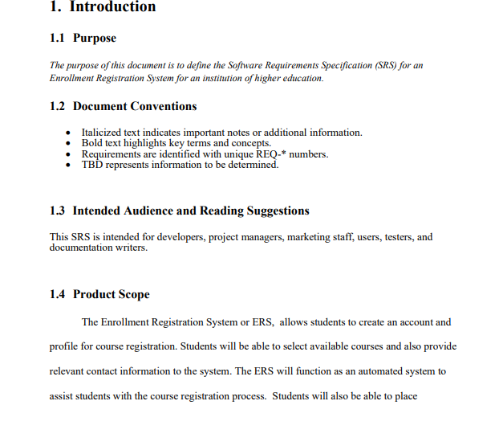
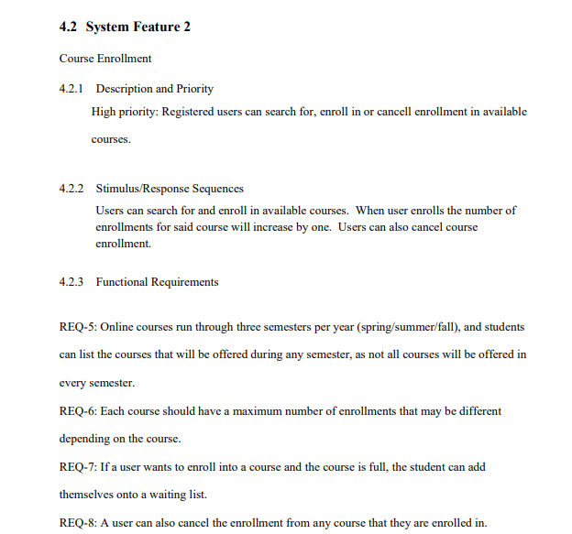
Software Requirements Specifications (SRS) Key Points
The SRS shows that we will develop a Course Registration Site that connects to a SQL Database using PHP. The Students should be able to Register on the site and then be able to browse, enroll and drop courses.

Slide 3
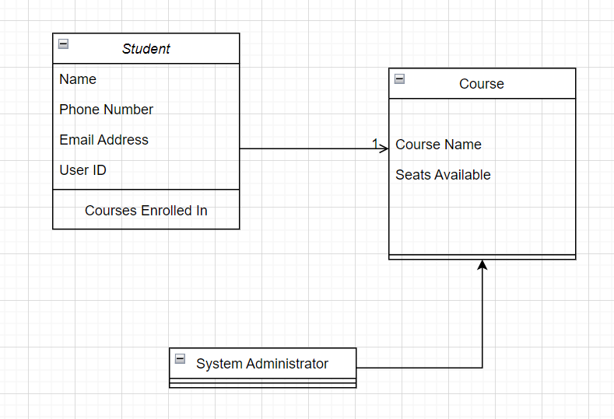
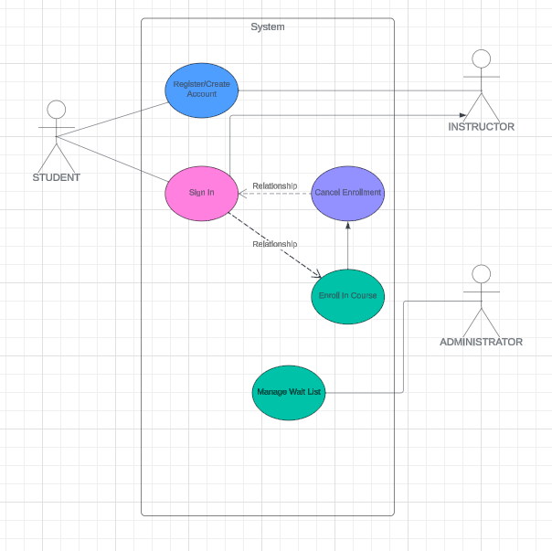
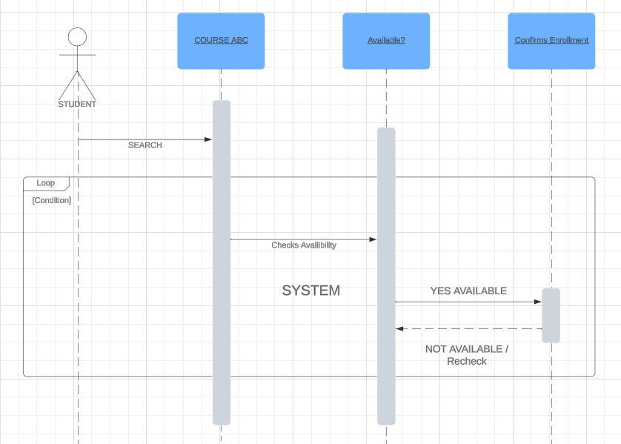
UML DESIGN
UML models will "illustrate" the requirements of the SRS and helps visualize how the system will function. Case Diagrams, Use Diagrams and Sequence Diagrams are common UML models.

Slide 4
Website Design
The site and pages were created using HTML. Each page uses PHP to connect to and manipulate the back-end DB.

Slide 5
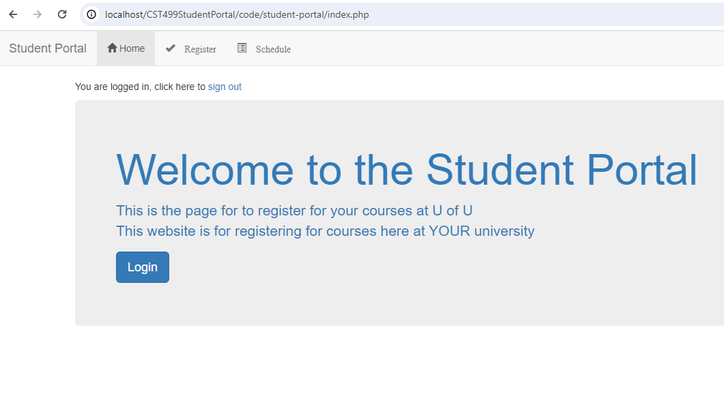
Landing Page
The Landing Page is the main page of the site. From here, users can register or login to select courses.

Slide 6
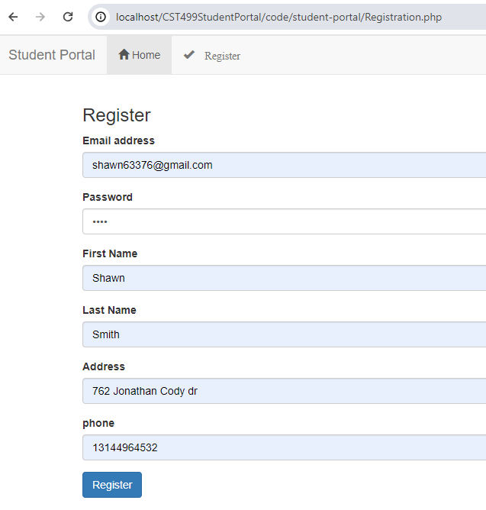
Registration Page
The Registration Page is where users input their personal information and when they hit the "register" button. The information is sent to and saved in the DB via PHP scripting.

Slide 7
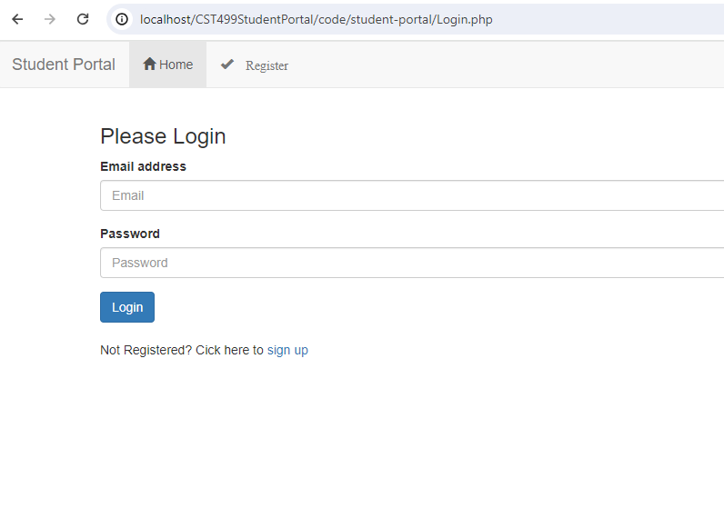
Login Page
After registration, users can login on this page. There is code on this PHP page to authenticate the users login info against the DB.

Slide 8
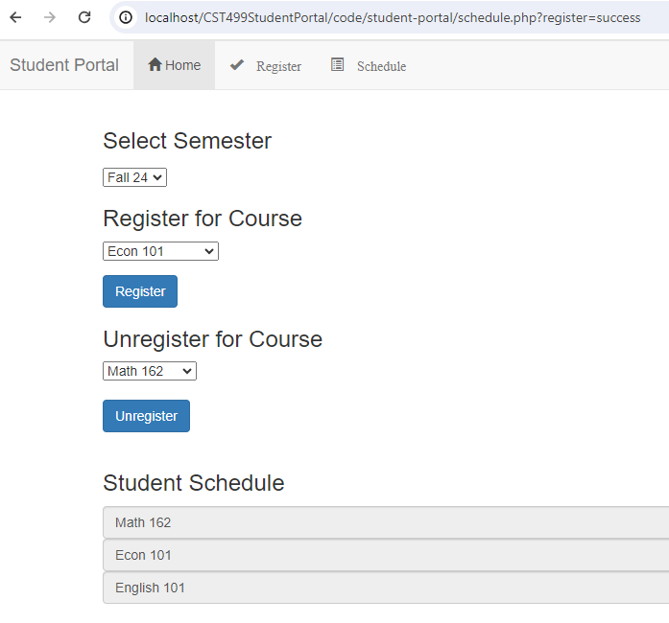
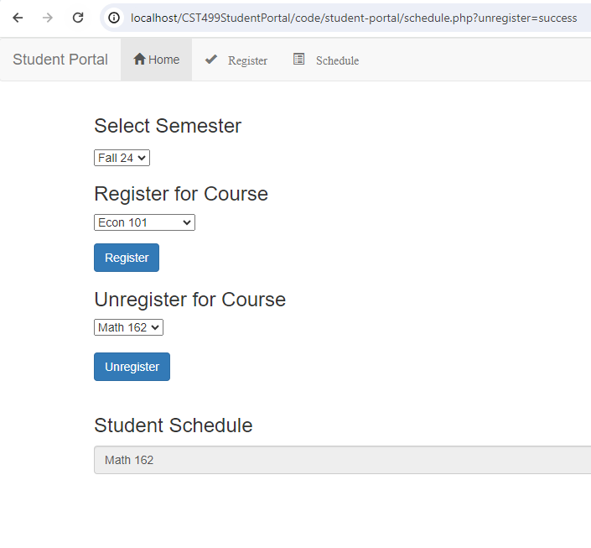
Adding / Removing Courses

Slide 9
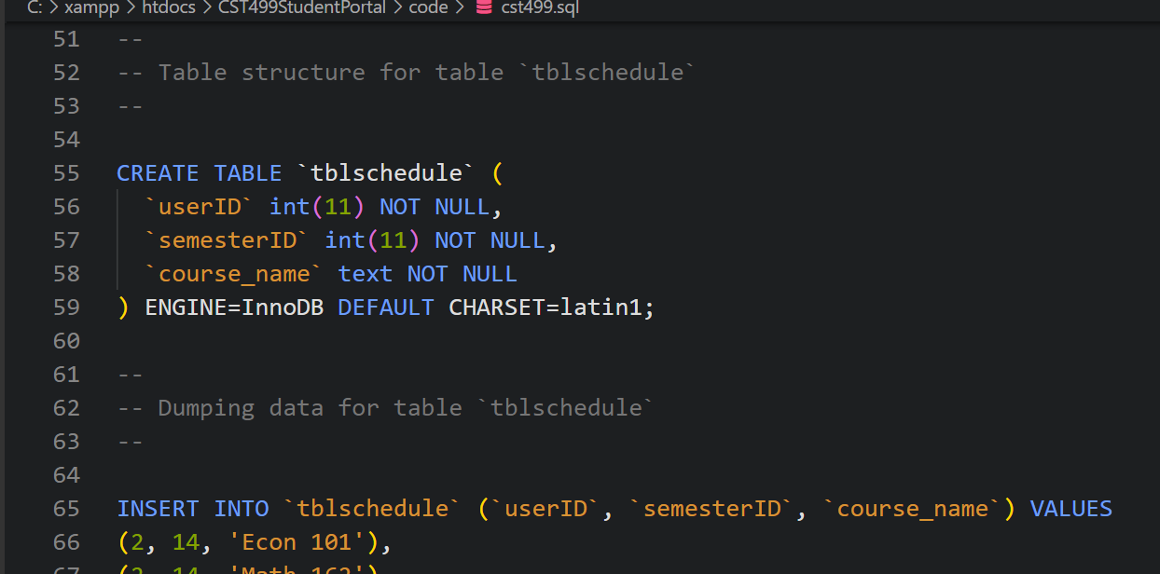
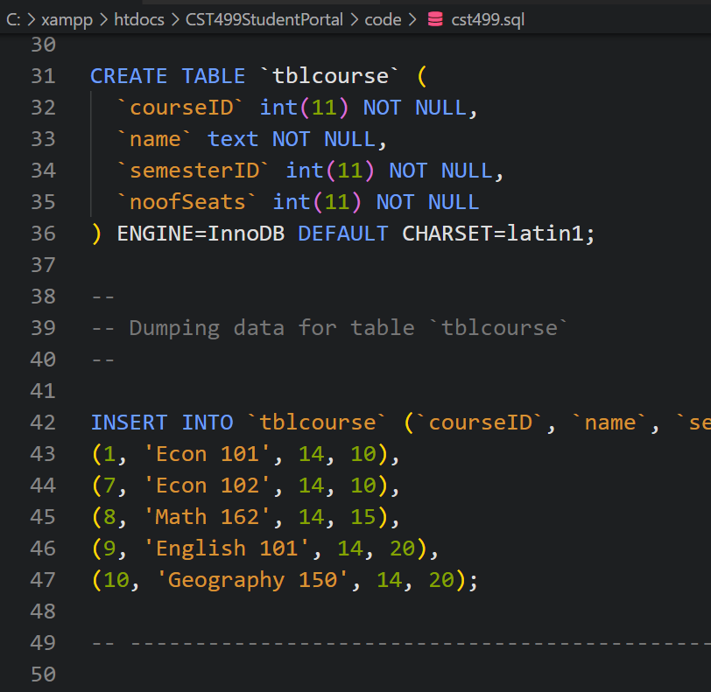
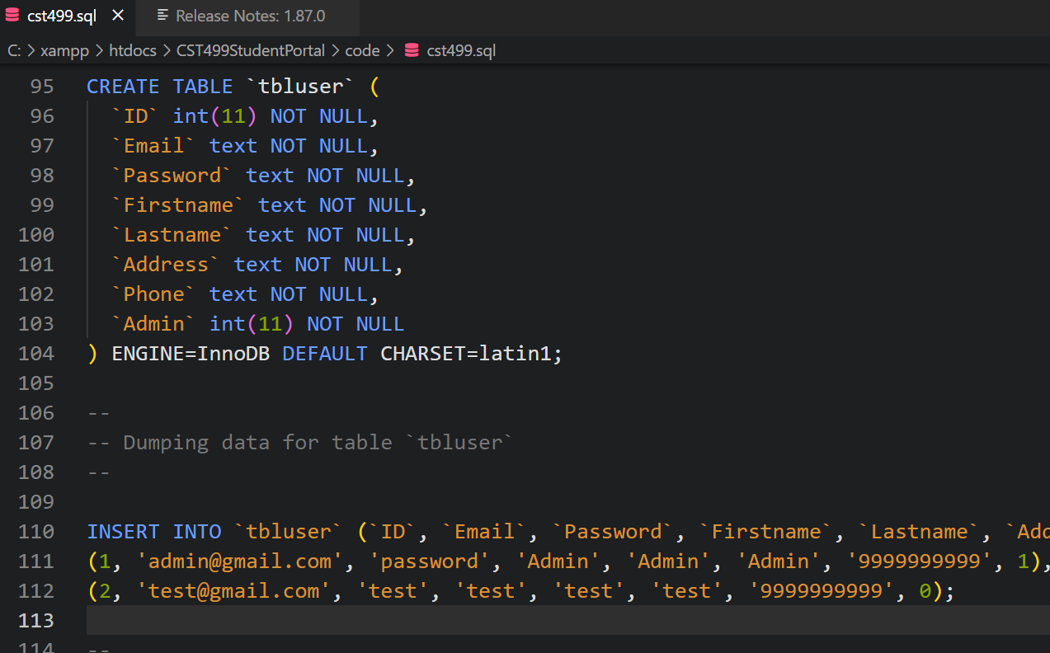
MySQL Database Construction
A simple SQL script was written to construct the DB and relevant tables including TblUser, TblSchedule, TblCourses and TblSemester

Slide 10
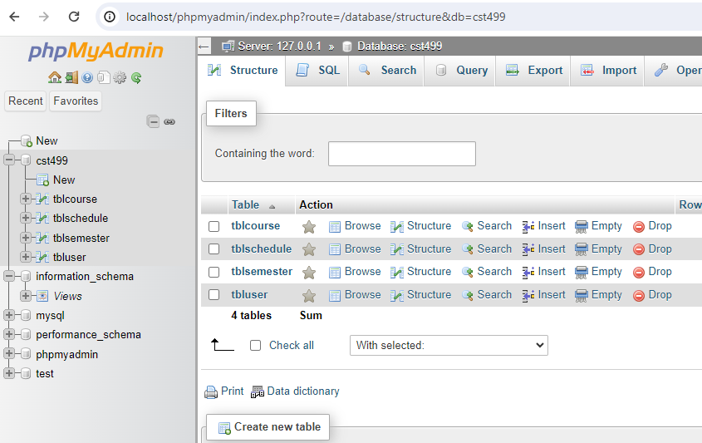
View of DB in MyPHPadmin after tables are added

Slide 11
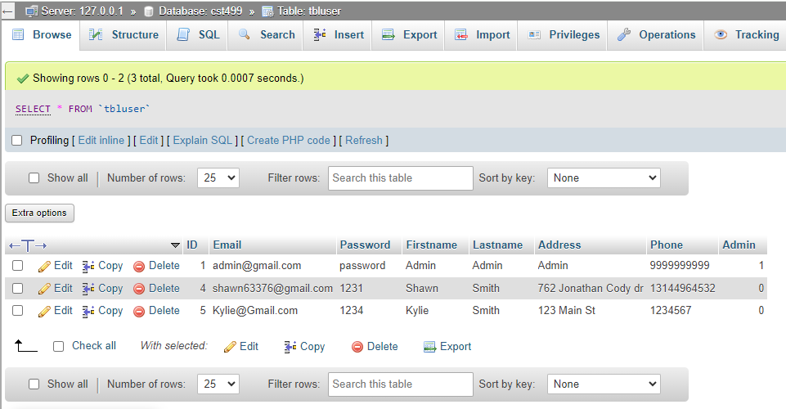
View of TblUser Table in MyPHPadmin after users are added via the web interface
The server-side code in the PHP scripts "talk" to the DB to add the fields in the TblUser table in this example.

Slide 12
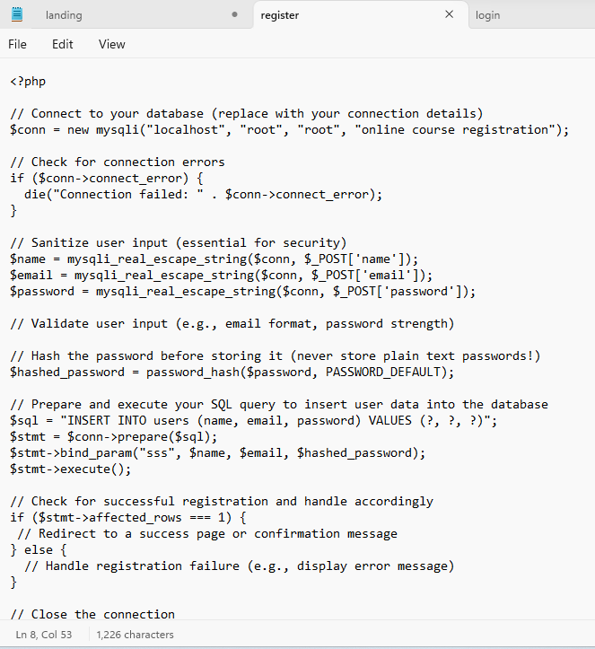
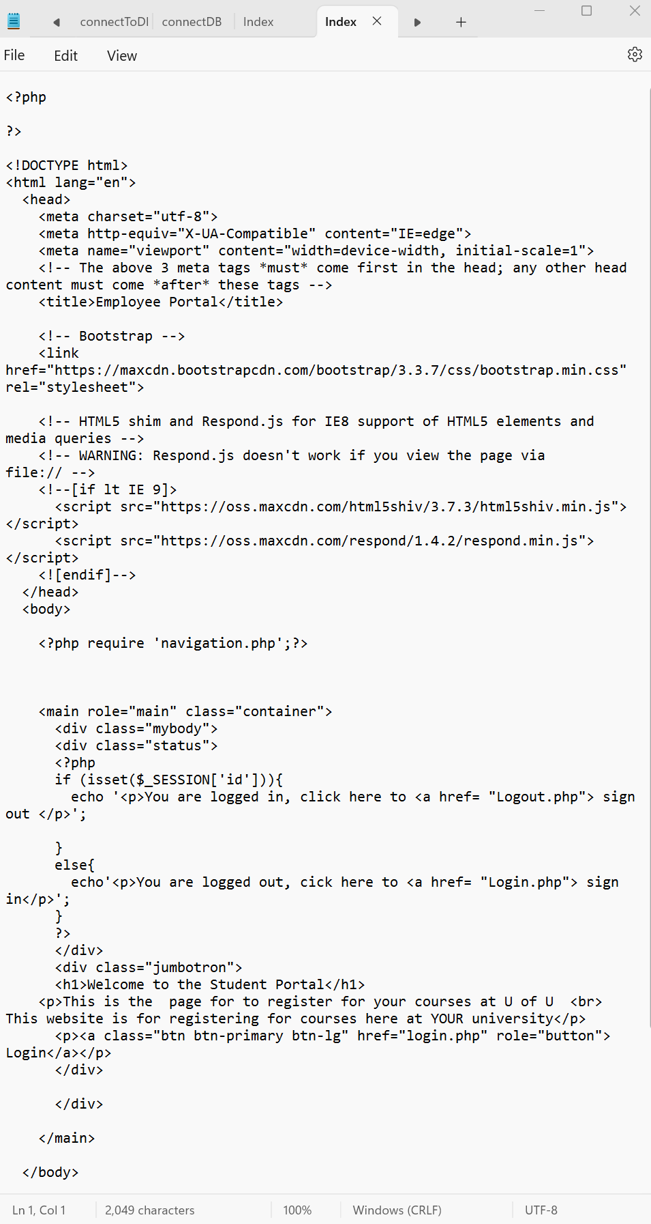
PHP CODE
Each page on the site is created using a separate PHP file. Pages that interact with other pages or the DB utilize SuperGlobals that run DB queries.

Slide 13
References:
Connolly, R., & Hoar, R. (2018). Fundamentals of web development (2nd ed.). Pearson.
GeeksforGeeks. (2020, September 9). Signup form using PHP and MySQL Database. https://www.geeksforgeeks.org/signup-form-using-php-and-mysql-database/?ref=ml_lbp
SiteGround. (n.d.). phpMyAdmin create and populate tables tutorial.
Tsui, F., Karam, O., & Bernal, B. (2018). Essentials of software engineering (4th ed.).

Slide 14
THANK YOU UAGC!

